Slide 1
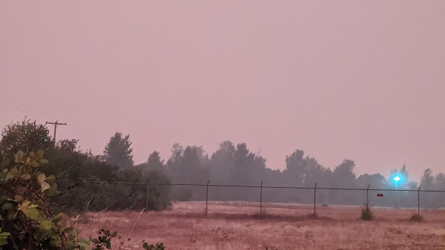
Corvallis, September 7th, 2020, 7:47 pm
Notes:
Hi my name is Francisco Guerrero, and I am a river scientist working at the Pacific Northwest National Lab and also as a courtesy faculty member in the College of Forestry, at Oregon State University. I’m from Colombia and have been living in Corvallis for the last 10 years. I want to start this talk with a brief personal story. September 7th, 2020, started as a normal day, until suddenly our apartment was flooded with smoke, and we had to evacuate.

Slide 2
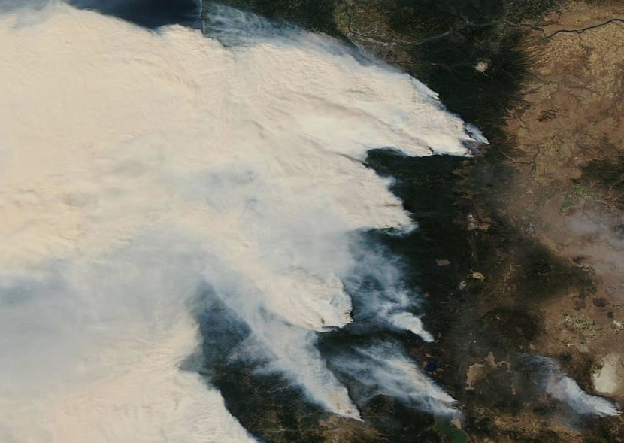

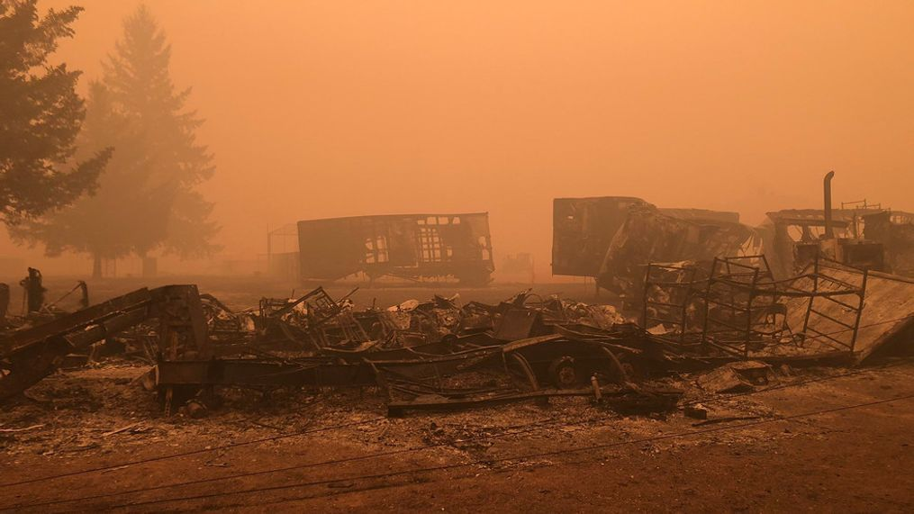
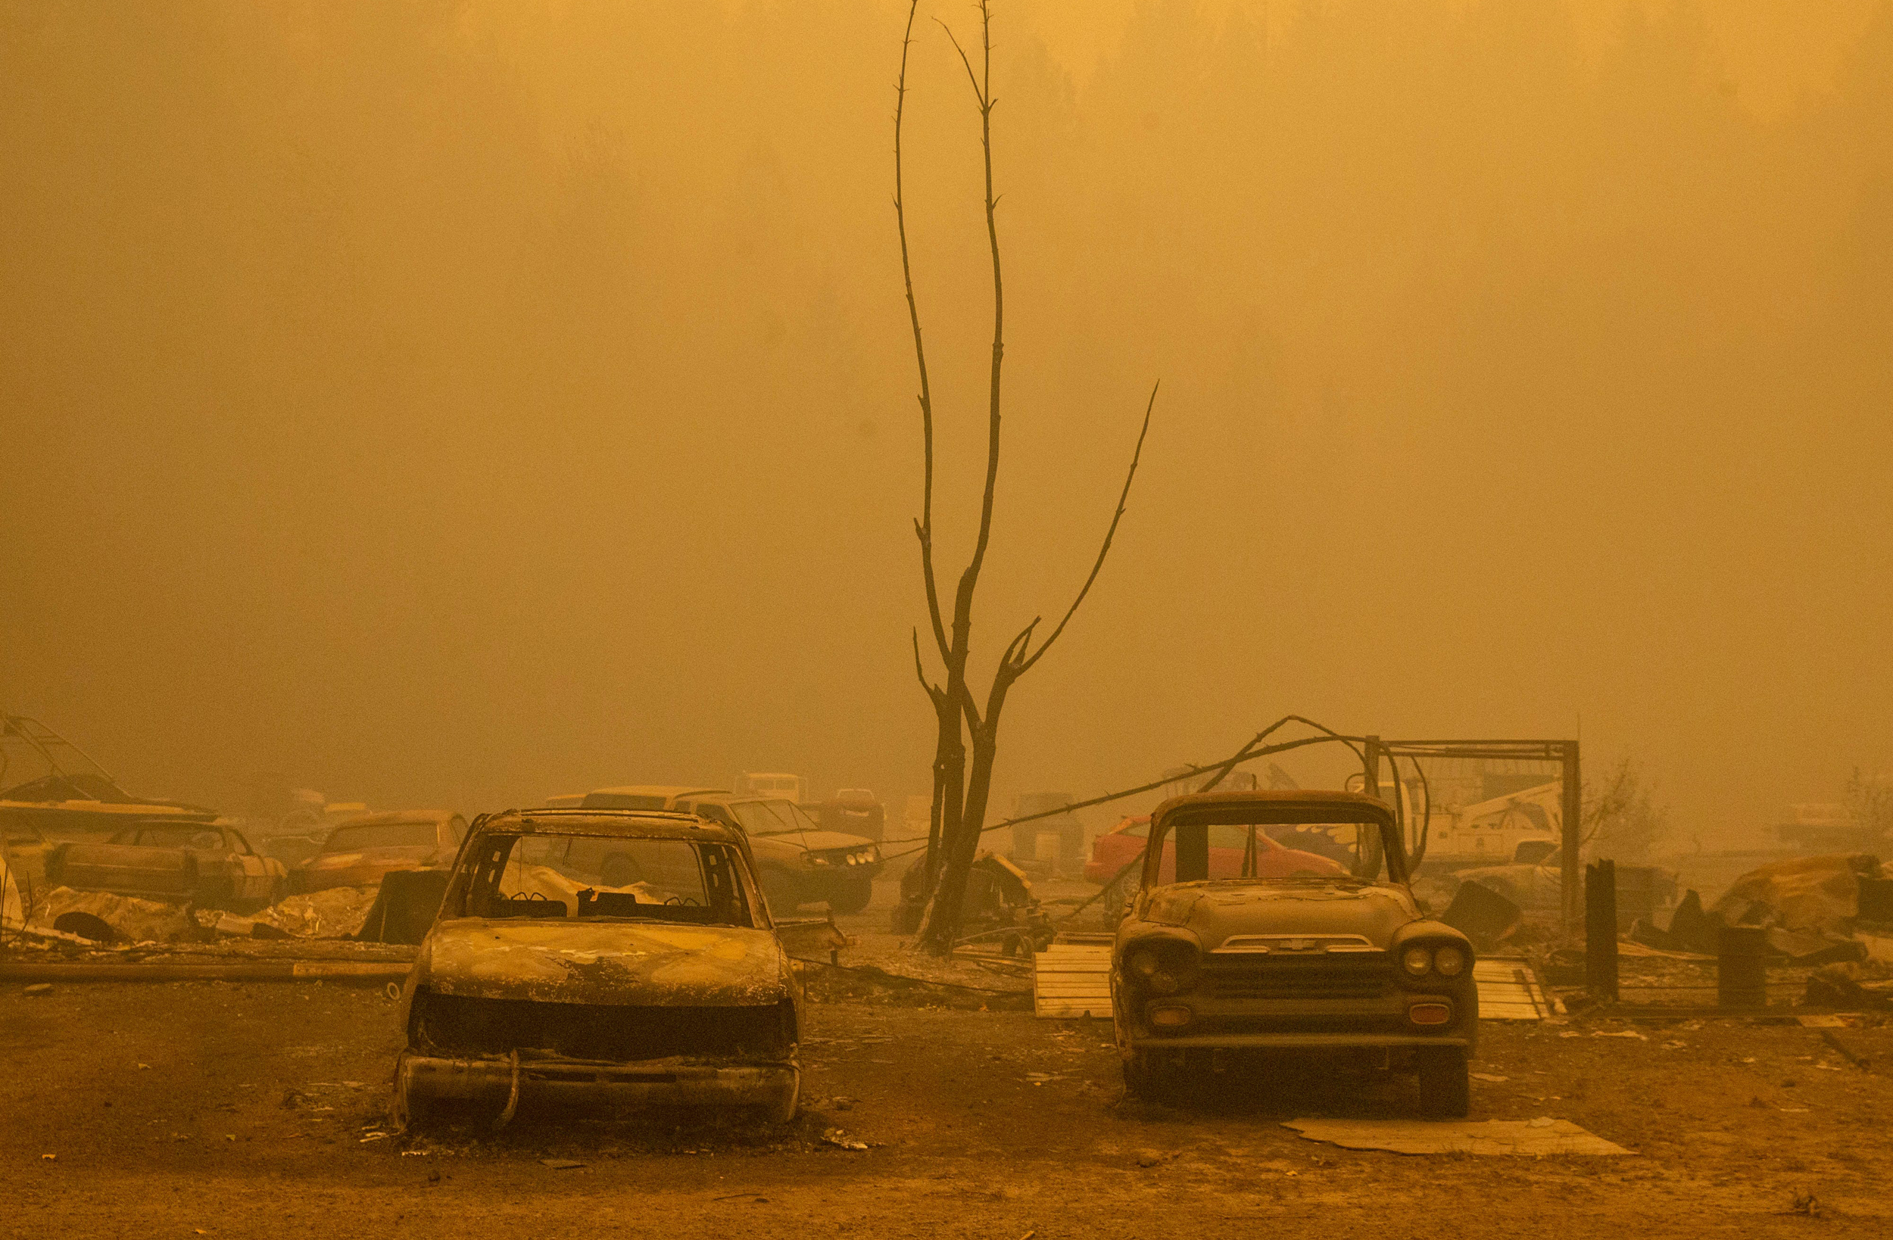
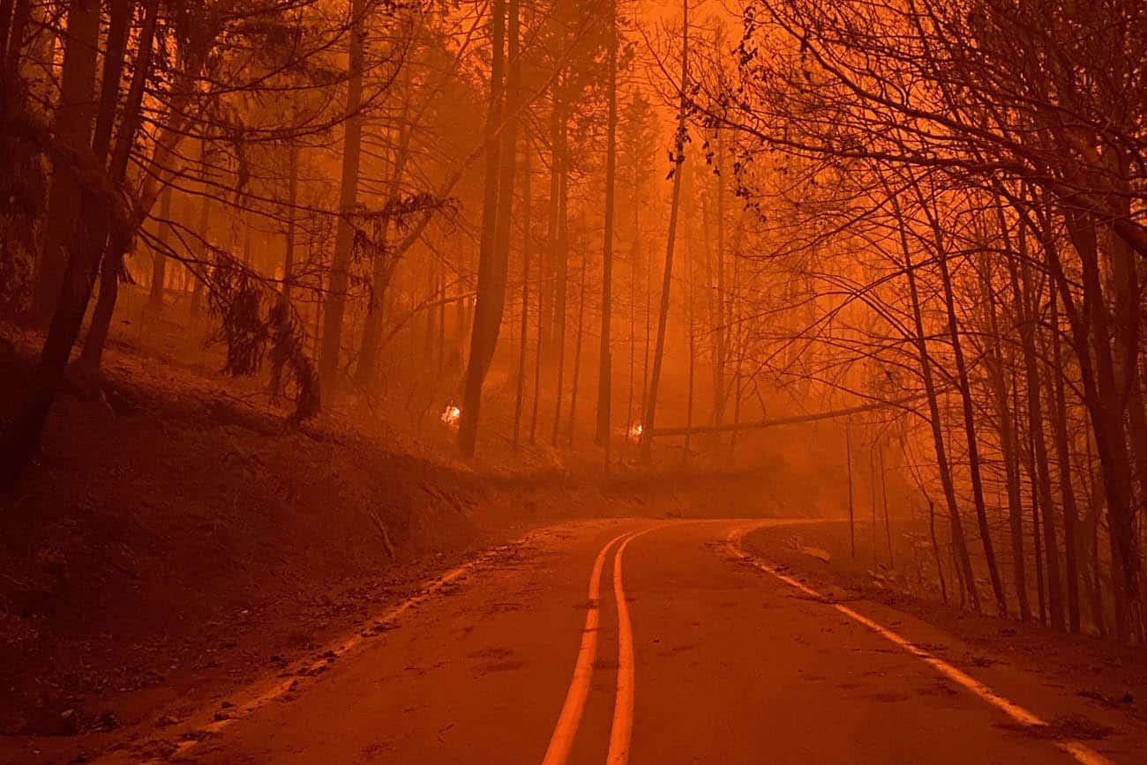
Labor Day Fires
Portland
Riverside
Salem
Newport
Beachy-Creek & Lionshead
Beachy Creek & Lionshead
Corvallis
Bend
Eugene
Holiday Farm
Holiday Farm
Archie Creek
Archie Creek
Notes:
We were heading to Eugene, where my in-laws live, in a bigger house with air filtration system. While on the road, with low visibility, winds speeding up, and trees falling, we really did not know how fast to go: driving slow meant spending more time on the road and driving fast meant to potentially crash against something and lose control of the car. We were facing tough choices in the worst moments possible.

Slide 3
Cascadia Burning
“The 2020 Labor Day fires were a wake-up call to many scientists, forest managers, policymakers, and the public….”
– Reilly et al., 2022
Reilly et al., 2022. Cascadia Burning: The historic, but not historically unprecedented, 2020 wildfires in the Pacific Northwest, USA. Ecosphere
Notes:
Those fires were a wake-up call for everyone. Since then, I worry about fires more than I ever had.

Slide 4
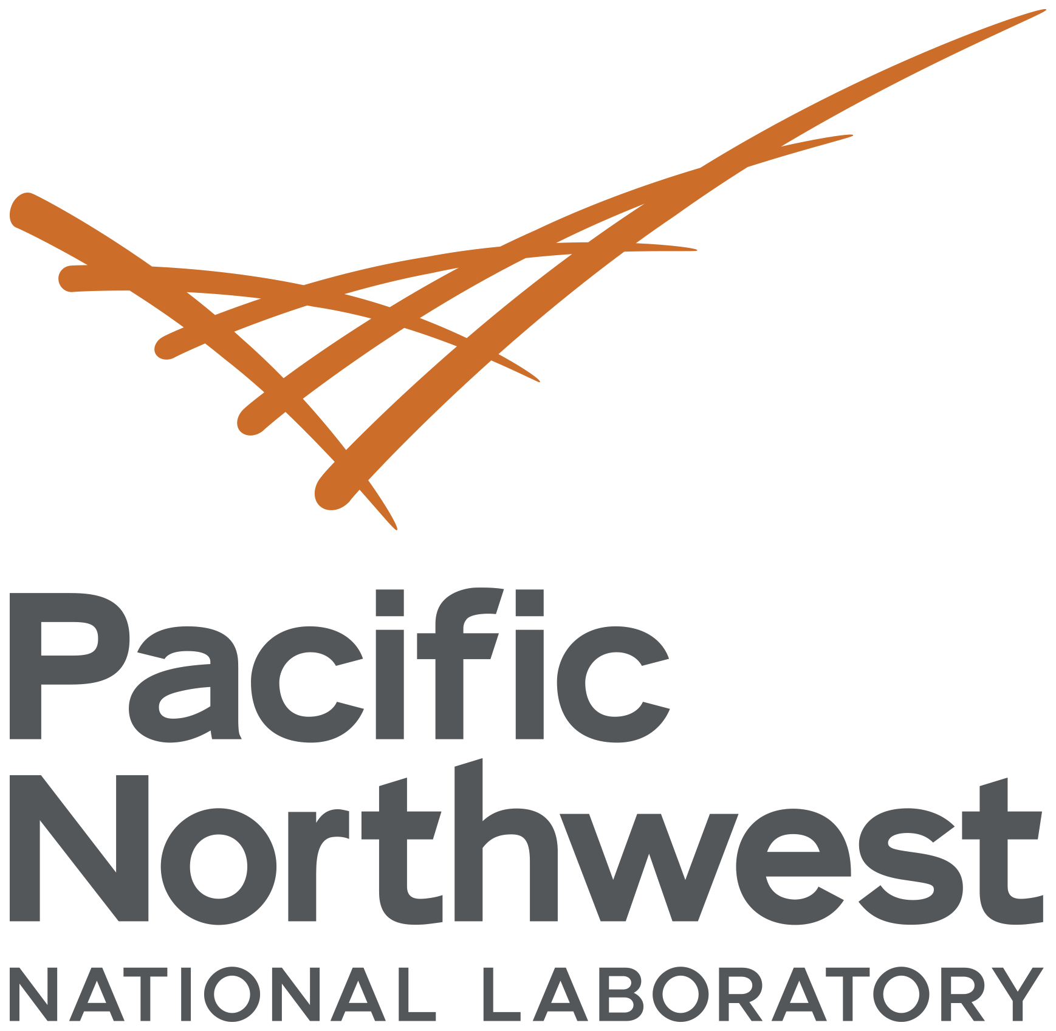

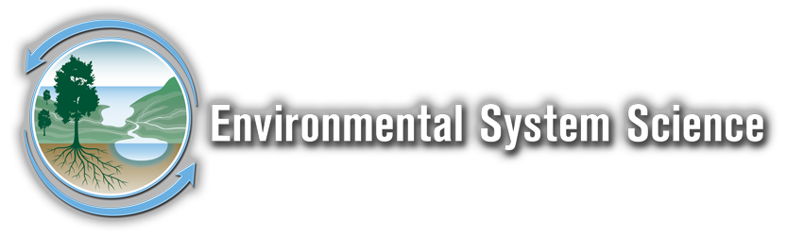

B
Burning Questions
What are the top emerging
research priorities related to
wildfires in watersheds?
Francisco J. Guerrero
Allison Myers-Pigg
June 6, 2023
Notes:
So, when I joined the Lab and found that my colleague Allison was working on the impacts of wildfires on watersheds, I did not think it twice, and decided to join her efforts. We are coordinating a synthesis paper trying to find the top emergent research priorities related to wildfires in watersheds.

Slide 5

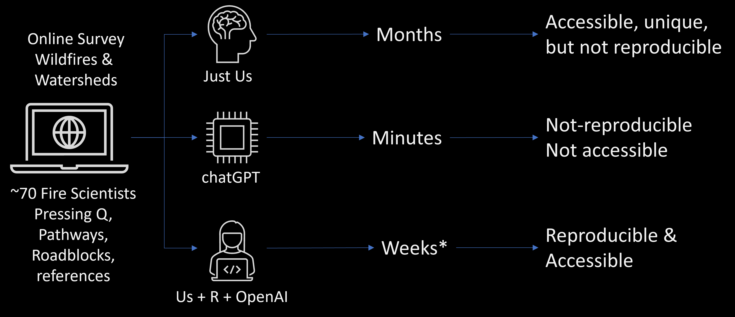
How fast is too fast?
Notes:
When I started working with Allison, she and her team of collaborators had surveyed several dozens of scientists to identify pressing questions, pathways, and roadblocks related to the role of fires in watershed ecosystems. After several months, they came with a first synthesis of topics encompassing more than 100 different questions submitted by the participants in the survey. Their results were quite accessible and even unique. But the manual synthesis could not be reproduced easily.
I proposed to Allison to use text mining, which is aided by artificial intelligence to process natural language. I also suggested that we should implement an open and reproducible workflow from the very beginning, so we could interact with those survey responders wanting to lead specific sections of the paper. While the total time spend in this activity could be condensed into a couple of weeks, it’s been a steep learning curve for us, since both Allison and I are efficient code users, but not computer programmers. That’s when I started asking chatGPT to help me debug my code. I am amazed by how fast it can find the error along multiple lines of computer scrabbles and suggest the correct command or even a new package to explore. With these extended coding capabilities, I propose to Allison tackle the challenge of creating open, accessible, and reproducible workflows for the project we are doing.

Slide 6
Black and Opaque Boxes for everyone!
Opaque
User interface
(e.g., chatGPT)
Notes:
Chat GPT is a clear example of an Opaque or Black box AI. We control the inputs, and can provide feedback on the outputs, but have no idea of what is happening inside.

Slide 7
The Glass Onion: Open & Inclusive
Workflows
Transparent
User interface
(e.g., chatGPT)
Multilayer
Engagement
(e.g., Quarto + GitHub)
Notes:
What would be even better are more transparent user interfaces that could allow you to explicitly observe the layers of complexity built into a system, without having to engage at those levels if you don’t want to do so. So, the way I envision these workflows is like a glass onion. You can see what is inside, and how is built, and engage with deeper layers only if you want.

Slide 8
The Glass Onion: Open & Inclusive
Workflows
User engagement
Product store
Production hub
Analytical engine
Knowledge base
Notes:
The structure we have for this onion is a knowledge base where all the raw data and ugly code lives (like code used for automatic downloads from the web), an analytical engine layer where scripts that provide essential functions for your analysis are stored. A production hub were those scripts are transformed into commented markdown documents or html files, a product store, where generated pdfs and notebooks are stored to be shared at ease with interested users, and finally, a user engagement layer, where the public and your colleagues come to learn what are you doing, and the main highligths of your research.

Slide 9
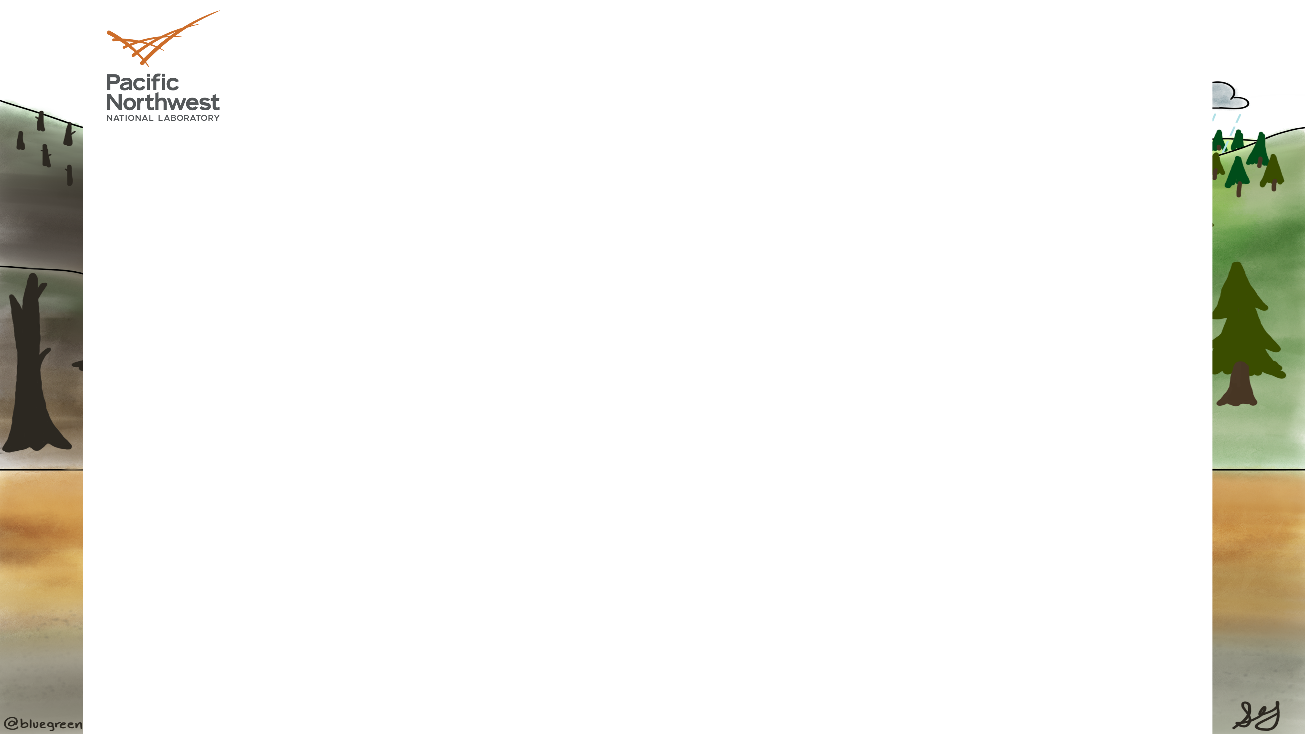
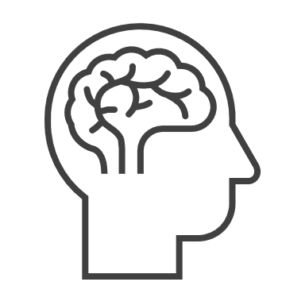
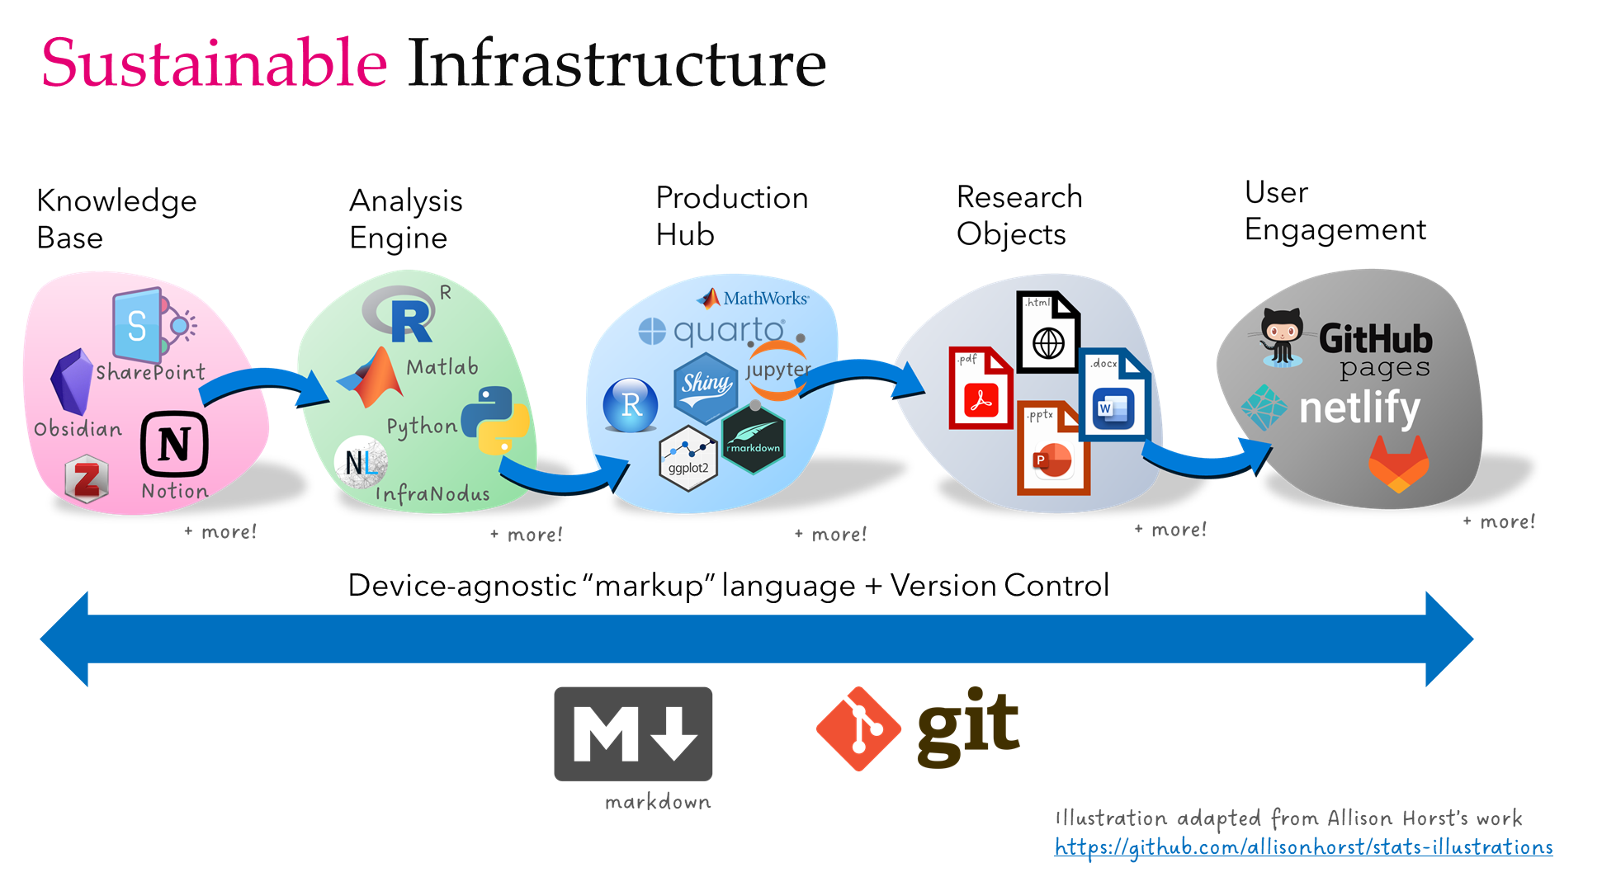
Open and Inclusive Workflows
Guerrero et al., 2022
Notes:
This system is multiplatform, device agnostic, and with version control.

Slide 10
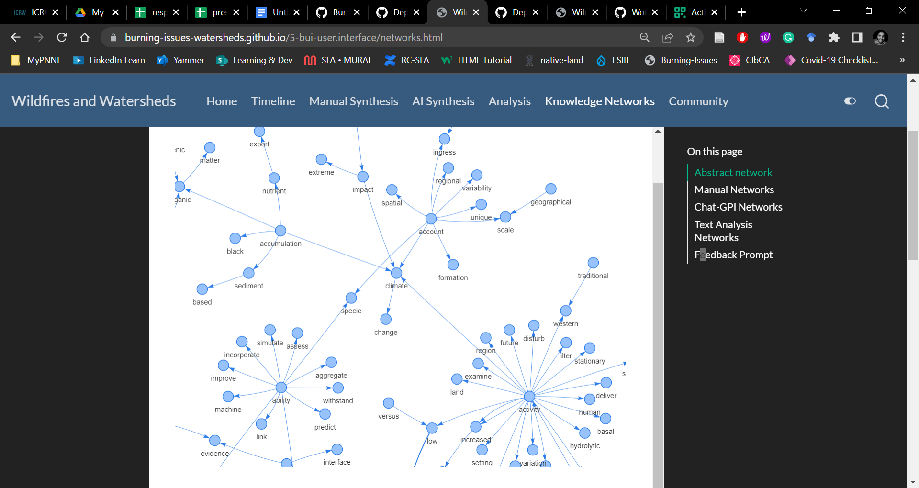
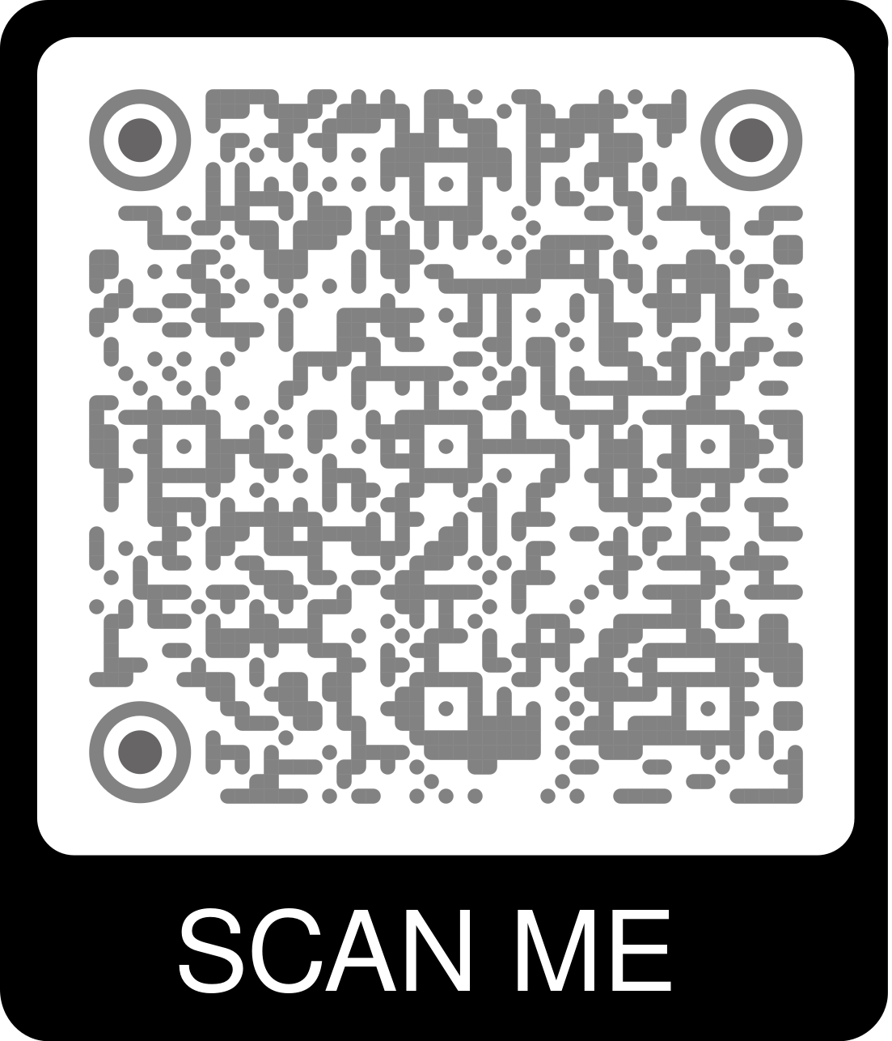
Interactive Knowledge Networks
Notes:
So, right now, you can scan the QR code on the screen and visit our user engagement for the project. The workflow behind this layer was created by people, and for people. I have extensive experience in science communication, and it has been a priority to make its content as accessible as possible.

Slide 11
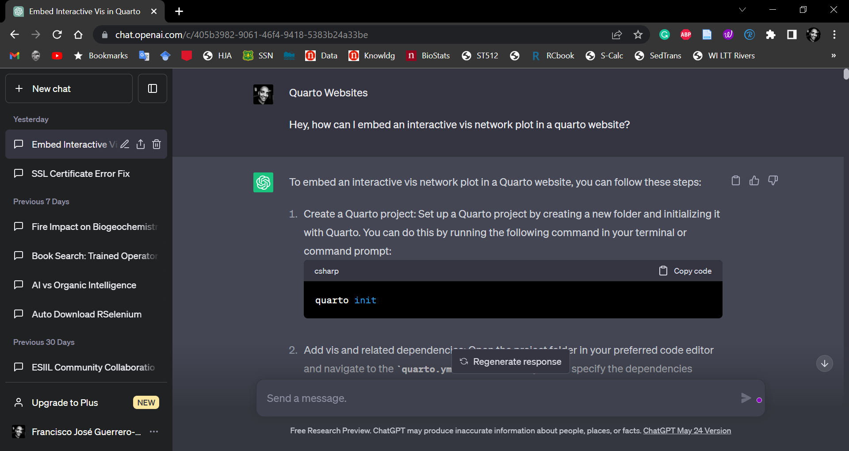
Code debugging with chatGPT
Notes:
But as I told you, I have found in AI tools, like chatGPT a strong ally when I need to answer How questions. I don’t like to ask for code generation because I feel I should retain that ability. However, if you feel like asking for code, this is the way I think about it: code outputs are going to be evaluated immediately and it is not something you want to share without that evaluation. Some scholars feel ok with using chatGPT for that purpose.

Slide 12
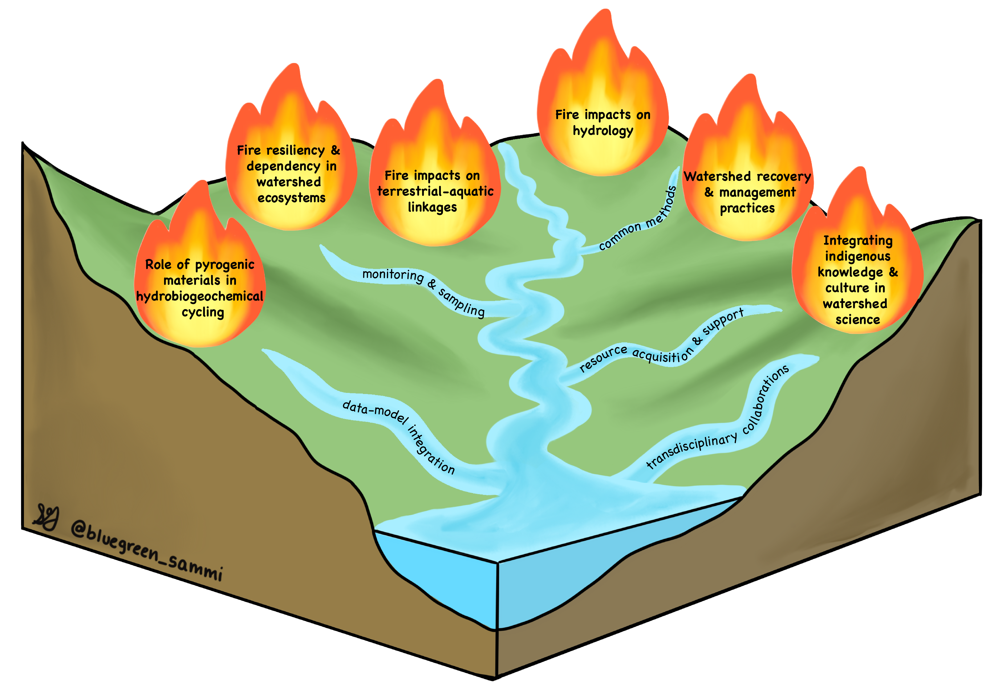
Burning Issues in Watershed Science
Notes:
So, our first human – machine interaction within our project is about the creation of workflows by humans, and code debugging by machines. The second way we have engaged with AI was to compare our manual synthesis exercise with the synthesis produced by chatGPT using the same inputs. When I joined the team, Allison and her collaborators had already identified the topics you see on the screen. You can also appreciate the artwork that went into generating this product making it quite unique.

Slide 13
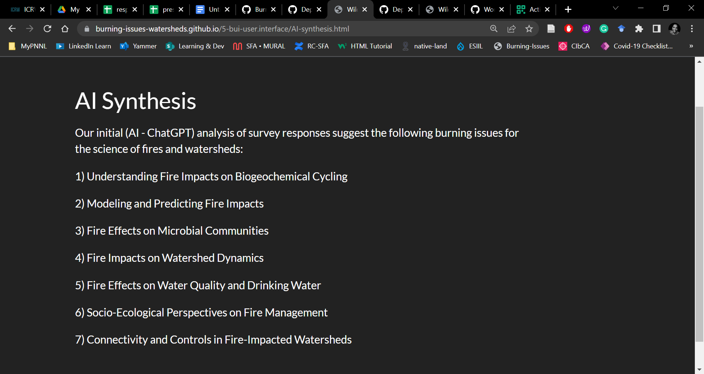
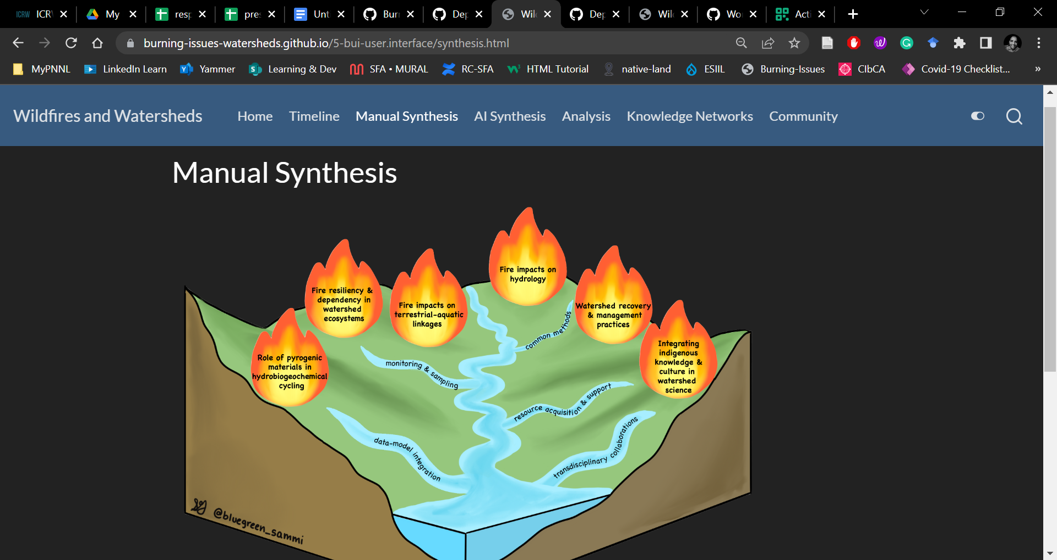
Faster Synthesis, but…
Nuance, context, Inclusion
Notes:
When I asked chatGPT to produce a similar number of topics, it produced the output on the screen in less than 1 minute. So, the processing speed is undeniable. Yet, ChatGPT did not include anything specific to indigenous knowledge. This is because only one among the 69 survey responders include this topic in his question. So, chatGPT has a clear bias against nuance and context, which can have a tremendous impact on inclusion.

Slide 14
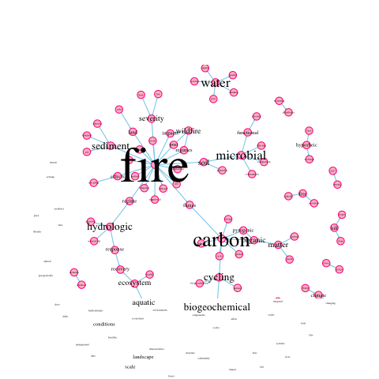
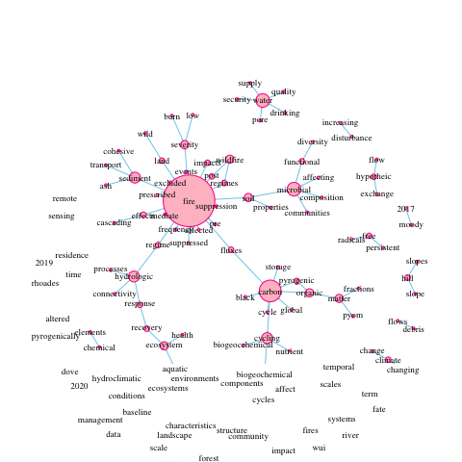
Discovery: Detail matters!
Notes:
Even in a benign synthesis exercise with our code for text analysis we can quickly appreciate how the dominant content can set the frame for the conversation. If we focus on the image to the left, where the font size is a function of the word frequency, you get a quick grasp on the overall topics across the questions. If we instead translate the frequency to the size of the nodes, we can appreciate smaller connections with profound effects on how we make sense of the effects of wildfires in watersheds via the concept of cascading disturbance effects.

Slide 15
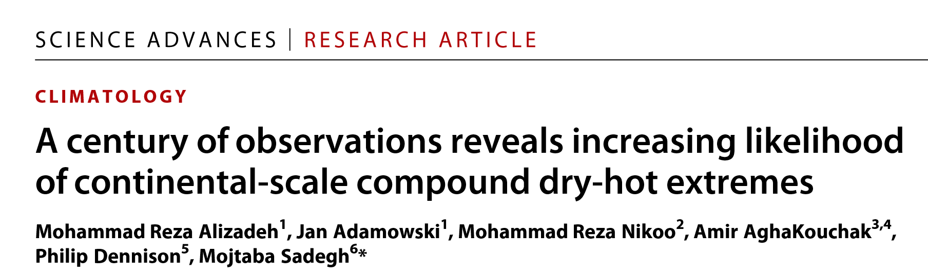
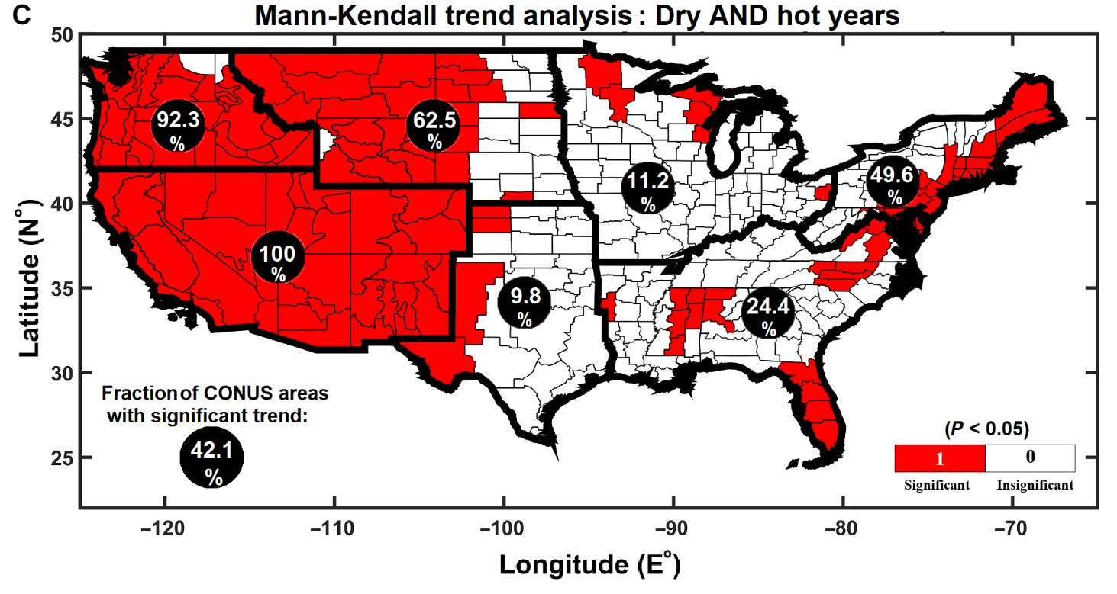
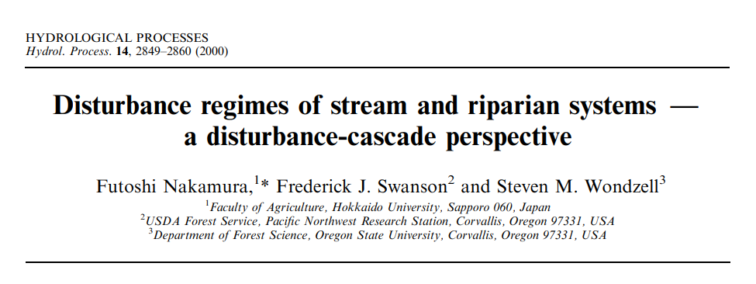
2020
Fig. 1. Nonparametric Mann-Kendall trend analysis. Red shaded areas show a statistically significant increase (at the 5% level) in concurrent dry AND hot extremes across CONUS over the past 122 years (1896–2017) at the annual scale. Fraction of area in each region and the entire CONUS with significant trends are also shown in the figure.
Notes:
This connection immediately points to two bodies of literature that are not well represented in our survey: that of compound hazards in climatology, and that of disturbance cascades in stream ecology, separated by more than two decades.
Also, Alizadeh’s work was being published while the labor days fires were spreading across the Pacific Northwest. How much advance notice do we need to prepare for disaster? How fast do we need science to go to translate findings into action?

Slide 16
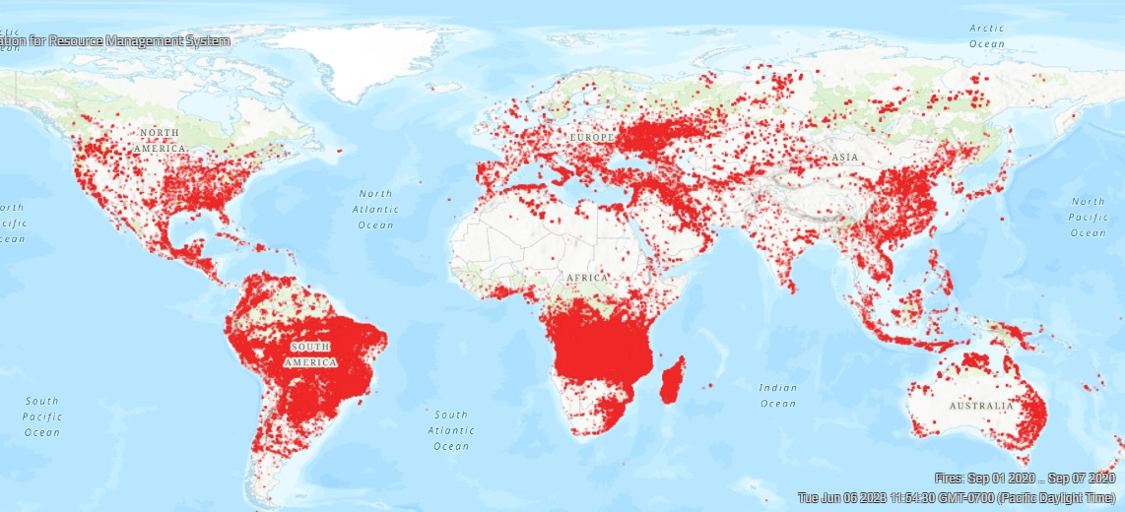
Week leading to Labor Day Fires
Active fires + Thermal Anomalies
Notes:
These are the active fires and thermal anomalies on the week leading to the Labor Day Fires.

Slide 17
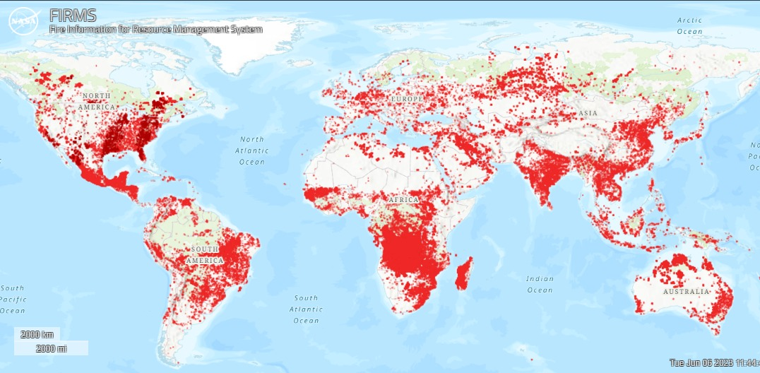
Week leading to Today
Active fires + Thermal Anomalies
Notes:
These are the active fires and thermal anomalies on the week leading to today. Will machine learning do for us what we have not being able to do?

Slide 18
Sensemaking
Discovery
Synthesis
Summarizing
Inclusive workflows
Code debugging
Notes:
So, I’ve talk about how, while synthesizing information impacts of wildfires on watersheds, we have combined human and artificial intelligence to keep momentum, while we use machines for code debugging, we design our workflows to be inclusive. While machines are extremely fast at summarizing, real synthesis require of the incorporation of nuance, context, and deliberate efforts to include all voices. Finally, while machine-learning algorithms can help us to map out the knowledge landscape to aid discovery, it is ultimately on us to identify fundamental hidden connections and assess the implications of our findings not only in the present but also in the past. So far, we still have the upper hand on this deal.

Slide 19
If machines are becoming artificially more intelligent, we must become organically wiser.
Notes:
We want to believe that if machines are becoming artificially more intelligent, we will be able to be organically wiser. But this is a long road for all of us and more is coming…

Slide 20
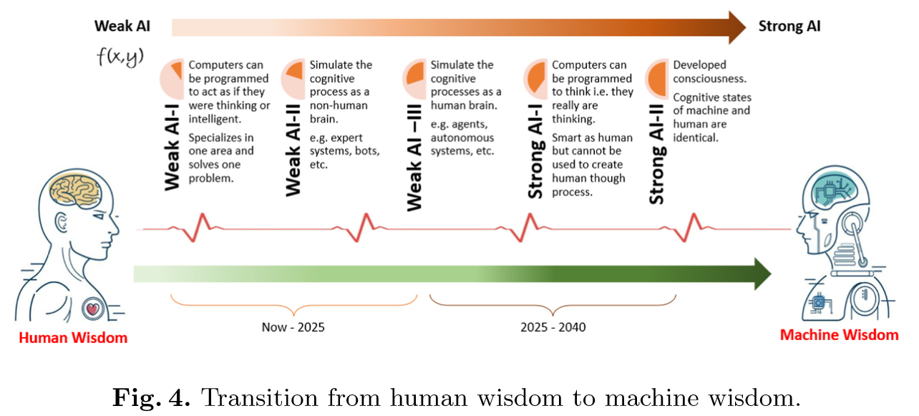
Yes, but…
Nagabushan et al., 2022. Towards Machine Learning to Machine Wisdom: A Potential Quest. S. N. Srirama et al. (Eds.): BDA 2021, LNCS 13147, pp. 261–275, 2021
Notes:
…as some scholars are voicing their enthusiasm for the quest of machine wisdom.

Slide 21
Questions?!
Comments & Reactions O.k.

Slide 22
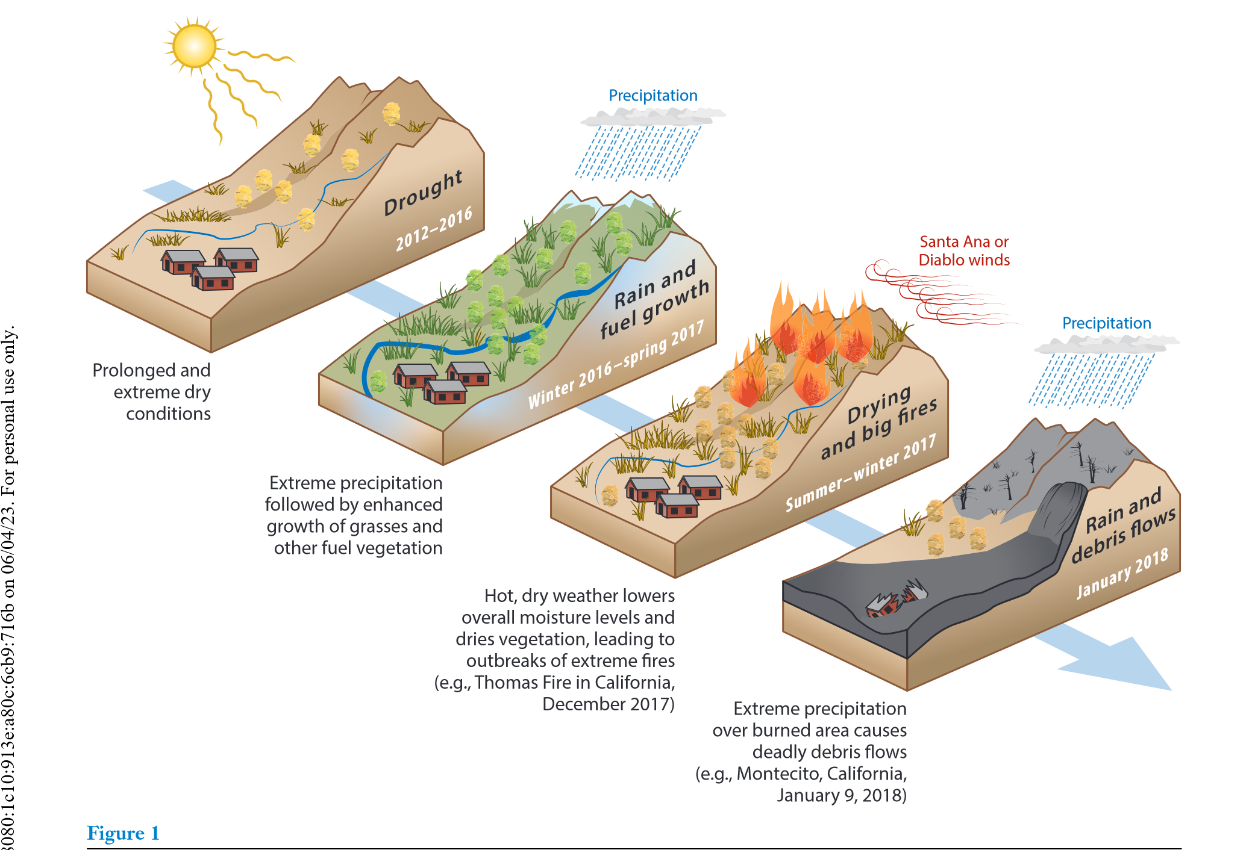
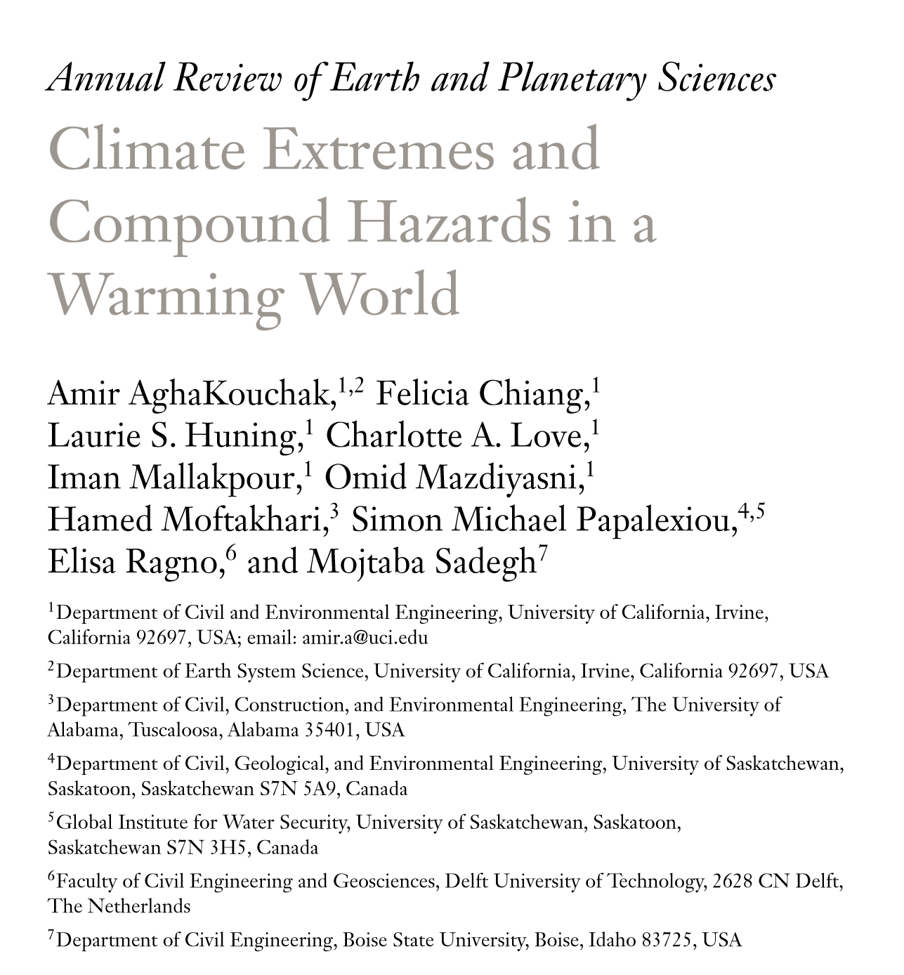

Slide 23
E
E
thics
Sensemaking
Discovery
Synthesis
Summarizing
Inclusive workflows
Code debugging

Slide 24

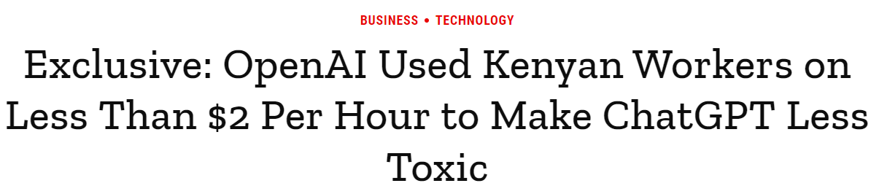
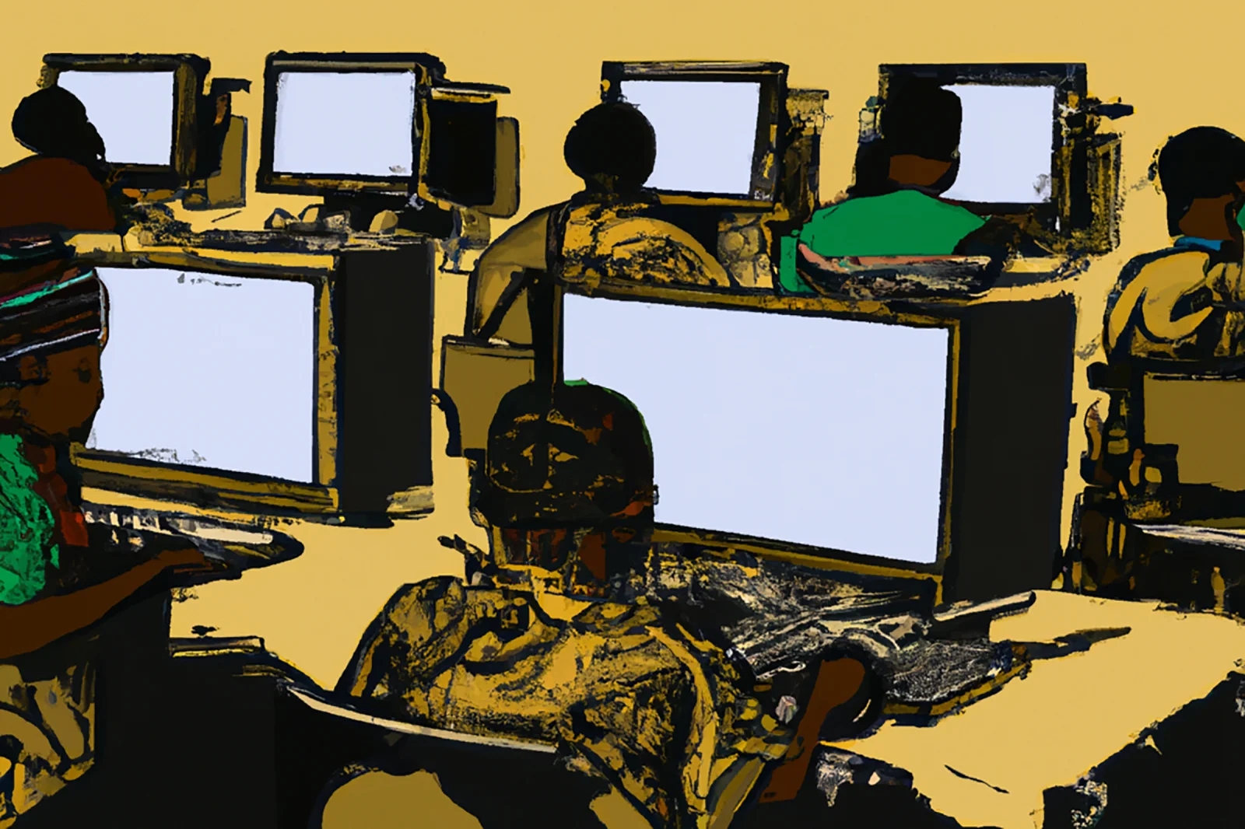
Discovery: Loud voices get louder!
This image was generated by OpenAI's image-generation software, Dall-E 2. The prompt was: "A seemingly endless view of African workers at desks in front of computer screens in a printmaking style." TIME does not typically use AI-generated art to illustrate its stories but chose to in this instance in order to draw attention to the power of OpenAI's technology and shed light on the labor that makes it possible.
Image generated by Dall-E 2/OpenAI

Slide 25
E
E
Discovery
Summarizing
Code debugging

